Slide 1
Learning Goals/Objectives
Be able to read, comprehend, trace, adapt and create Python code that uses:
Data types & casting - understanding the different data formats that variables & lists use, and how to convert between them.
Random - how to generate random numbers and use them in programs
Modulo - how to calculate the remainder of an integer division and why this is useful

Slide 2
Data Types

Slide 3
What is a data type?
A data type is a setting for a variable. It tells the variable what sort of data it will store.
At the moment, we have only used two data types, the string and the int.
What type of data does a string store?
What type of data does an int store?
Notes:
Strings store text data

Slide 4
Data Types in Python
String - Text
Int - Whole numbers
Float (also called Real in other coding languages) - numbers with decimals.
Notes:
We’ve used strings and ints before, now we are introducing floats. There are other data types too, but we will stick with these three for the moment.

Slide 5
Type - How To Code
The type() function returns the data type of some data or a variable
Put the data in the brackets as a parameter.
type(5.4)
num1 = 5
print(type(num1))
OR put the variable containing the data in the brackets as a parameter.
Notes:
The first line WILL NOT output anything.
The last line will, as the print command has been used.

Slide 6
Programming – Casting (Changing One Data Type To Another)
int(data/variable)
float(data/variable)
str(data/variable)
Notes:
You can use either the actual data or a variable containing the data as the parameter

Slide 7
Programming – Casting Int
x = int(1) y = int(2.8) z = int("3")
# x will be 1
# y will be 2
# z will be 3
Notes:
Students should predict what will be returned by each cast.

Slide 8
Programming – Casting Float
x = float(1) y = float(2.8) z = float("3") w = float("4.2")
# x will be 1.0
# y will be 2.8
# z will be 3.0
# w will be 4.2

Slide 9
Programming – Casting String
x = str("s1") y = str(2)
z = str(3.0)
# x will be 's1’
# y will be ‘2’
# z will be '3.0'

Slide 10
Casting - How To Code
Casting lets us convert one data type into another.
2. Put the data OR the variable in brackets as the parameter.
Put the name of the data type you want to convert to.
int(data/variable)
float(data/variable)
str(data/variable)
Notes:
The first line WILL NOT output anything.
The last line will, as the print command has been used.

Slide 11
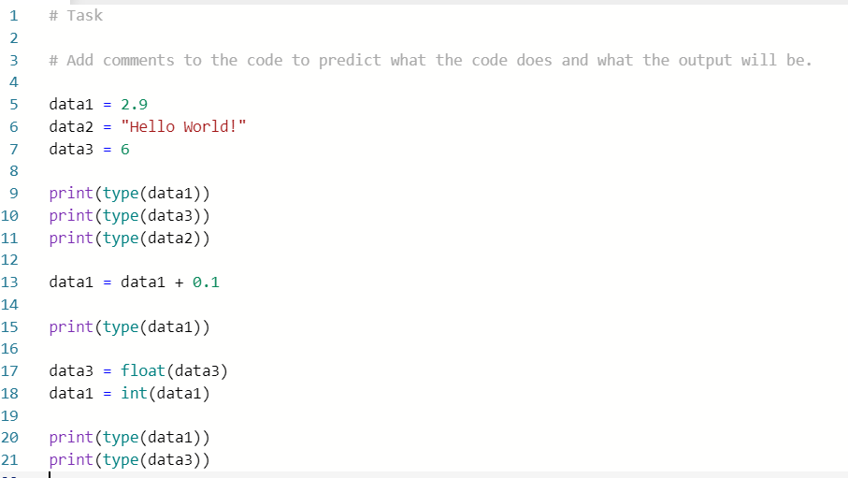
Task - Predict & Run

Slide 12
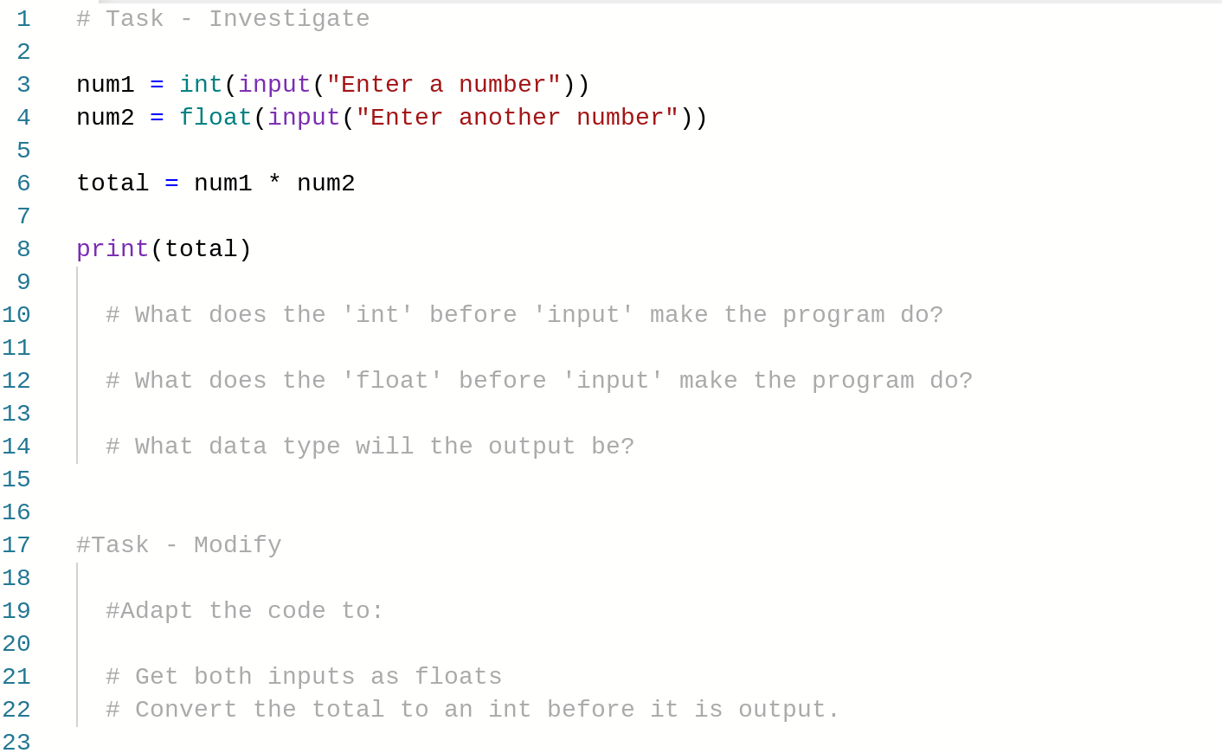
Task - Investigate & Modify
https://repl.it/@MrAColley/2202-Type-and-Cast-Investigate-and-Modify

Slide 13
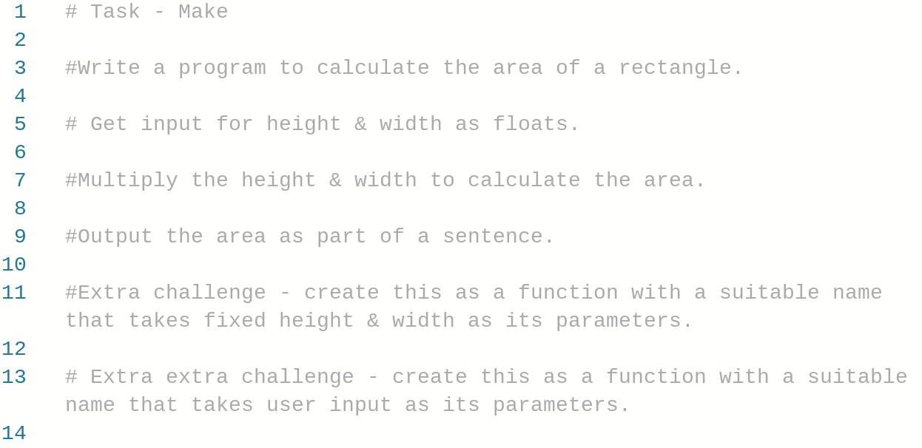
Task - Make
https://repl.it/@MrAColley/2203-Type-and-Cast-Make

Slide 14
Random Numbers
Notes:
No further examples here, the one on slide 2 and in the repls are more than enough. We are just using the print command inside the functions.

Slide 15
Random Numbers in Python
Python has lots of pre-written features & functions that we can use.
Often, these features are grouped together and called libraries.
To use a library we have to import it (you only have to do this once).
It is common practice to put all of your imports at the top of your code.
The library we are going to use for random numbers is called random

Slide 16
Random- How To Code
The randint(x,y) function takes 2 parameters.
x is the lowest random number that can be picked.
y is the largest.
The program will pick a number between these two limits.
3. Put your upper and lower limits in the brackets as parameters.
Import the library (you only have to do this once)
import random
random.randint(1,20)
2. Type the name of the library, a . and the name of the function you want to use.
Notes:
The first line WILL NOT output anything.
The last line will, as the print command has been used.

Slide 17
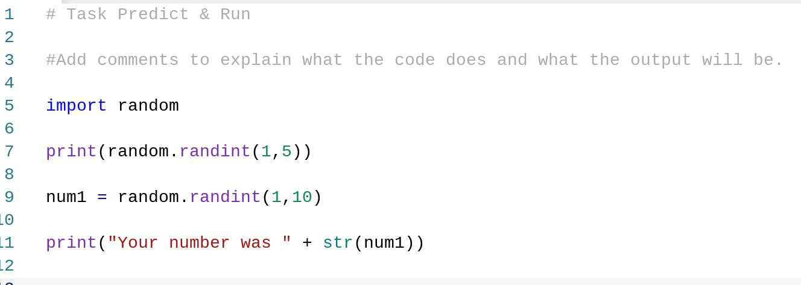
Task - Predict & Run
https://repl.it/@MrAColley/2204-Random-Predict-and-Run

Slide 18
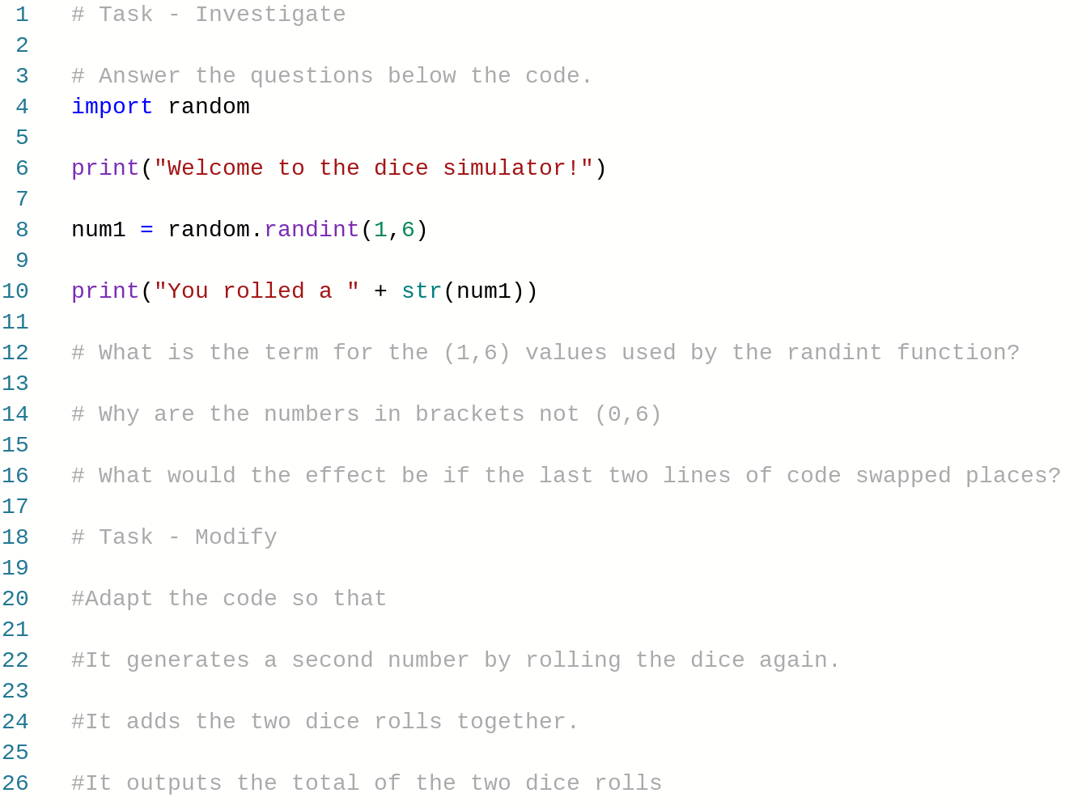
Task - Investigate & Modify
https://repl.it/@MrAColley/2205-Random-Investigate-and-Modify

Slide 19
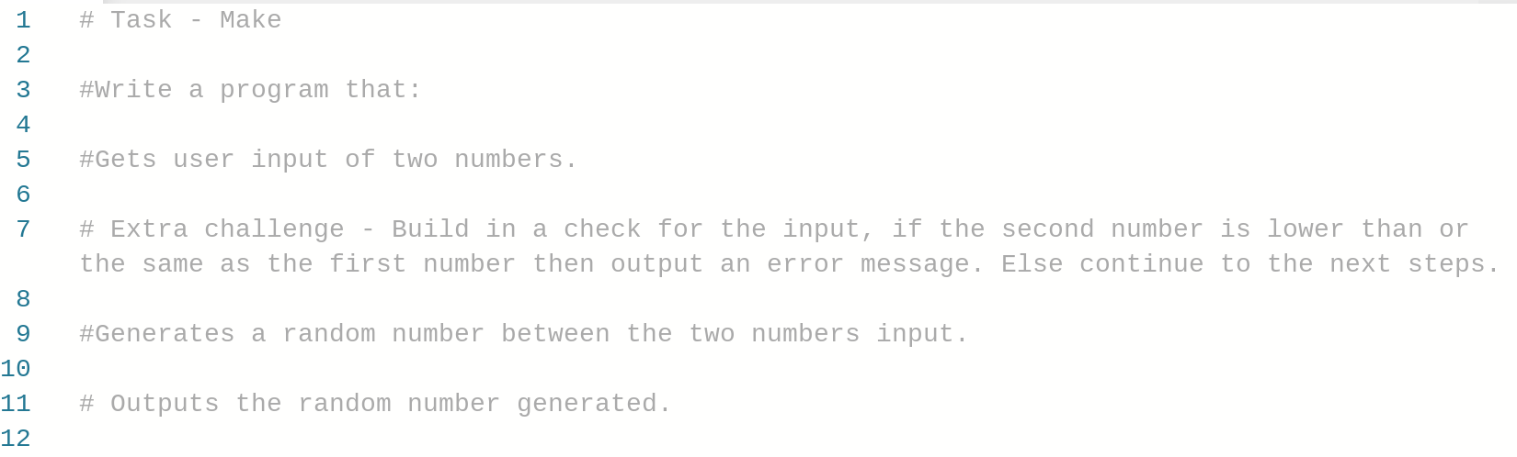
Task - Make
https://repl.it/@MrAColley/2206-Random-Make

Slide 20
Modulus
Notes:
No further examples here, the one on slide 2 and in the repls are more than enough. We are just using the print command inside the functions.

Slide 21
Modulus in Python
3 MOD 1 = 3 remainder 0, so the value returned would be 0.
5 MOD 2 = 2 remainder 1, so the value returned would be 1.
14 MOD 4 = 3 remainder 2, so the value returned would be 2.

Slide 22
What Value Will Be Returned By….
7 MOD 6
29 MOD 4
15 MOD 5
9 MOD 7
35 MOD 4
Notes:
1
1
0
2
3

Slide 23
Modulus - How To Code
The modulus operator returns the remainder of integer division.
2. Use the % symbol for modulus.
Put the dividend on the left.
12 % 5
3. Put the divisor on the right.
Notes:
Make it clear that only the remainder will be returned.
Order matters with division - put the dividend on the left and the divisor on the right

Slide 24
Modulus With Variables
The modulus operator returns the remainder of integer division.
num1 = 12
num2 = 5
remainder = num1 % num2
Notes:
Make it clear that only the remainder will be returned.
Order matters with division - put the dividend on the left and the divisor on the right

Slide 25
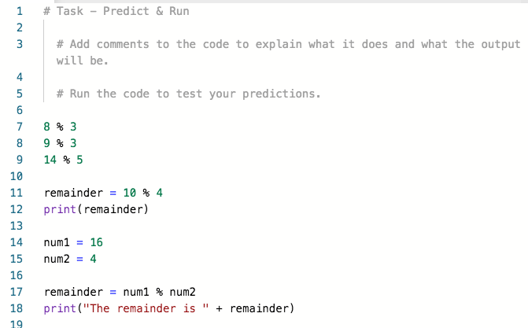
Task - Predict & Run
https://repl.it/@MrAColley/2207-Modulus-Predict-and-Run

Slide 26
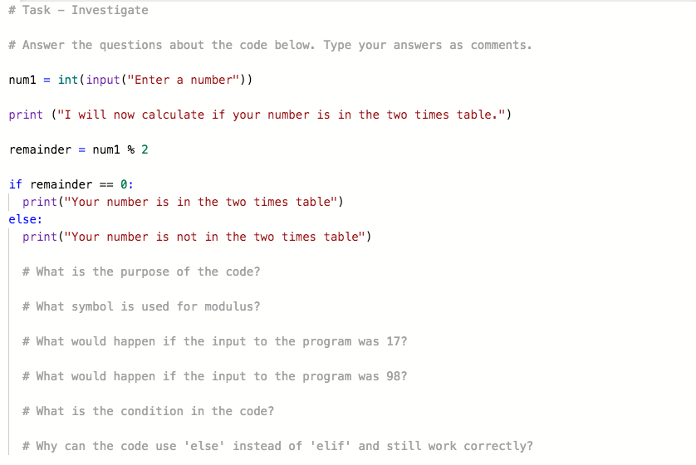
Task - Investigate
https://repl.it/@MrAColley/2208-Modulus-Investigate-and-Modify

Slide 27
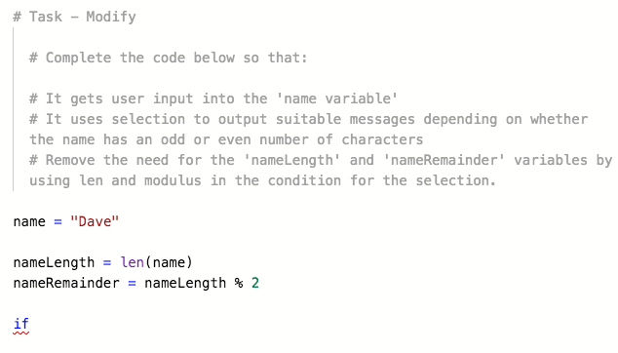
Task - Modify
https://repl.it/@MrAColley/2208-Modulus-Investigate-and-Modify

Slide 28
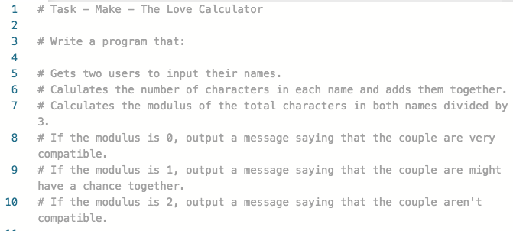
Task - Make
https://repl.it/@MrAColley/2209-Modulus-Make

